Slide 1
2022 Robotics Intern Demonstration
Kefeng Huang
https://github.com/t1mkhuan9/mycobot_ros

Slide 2
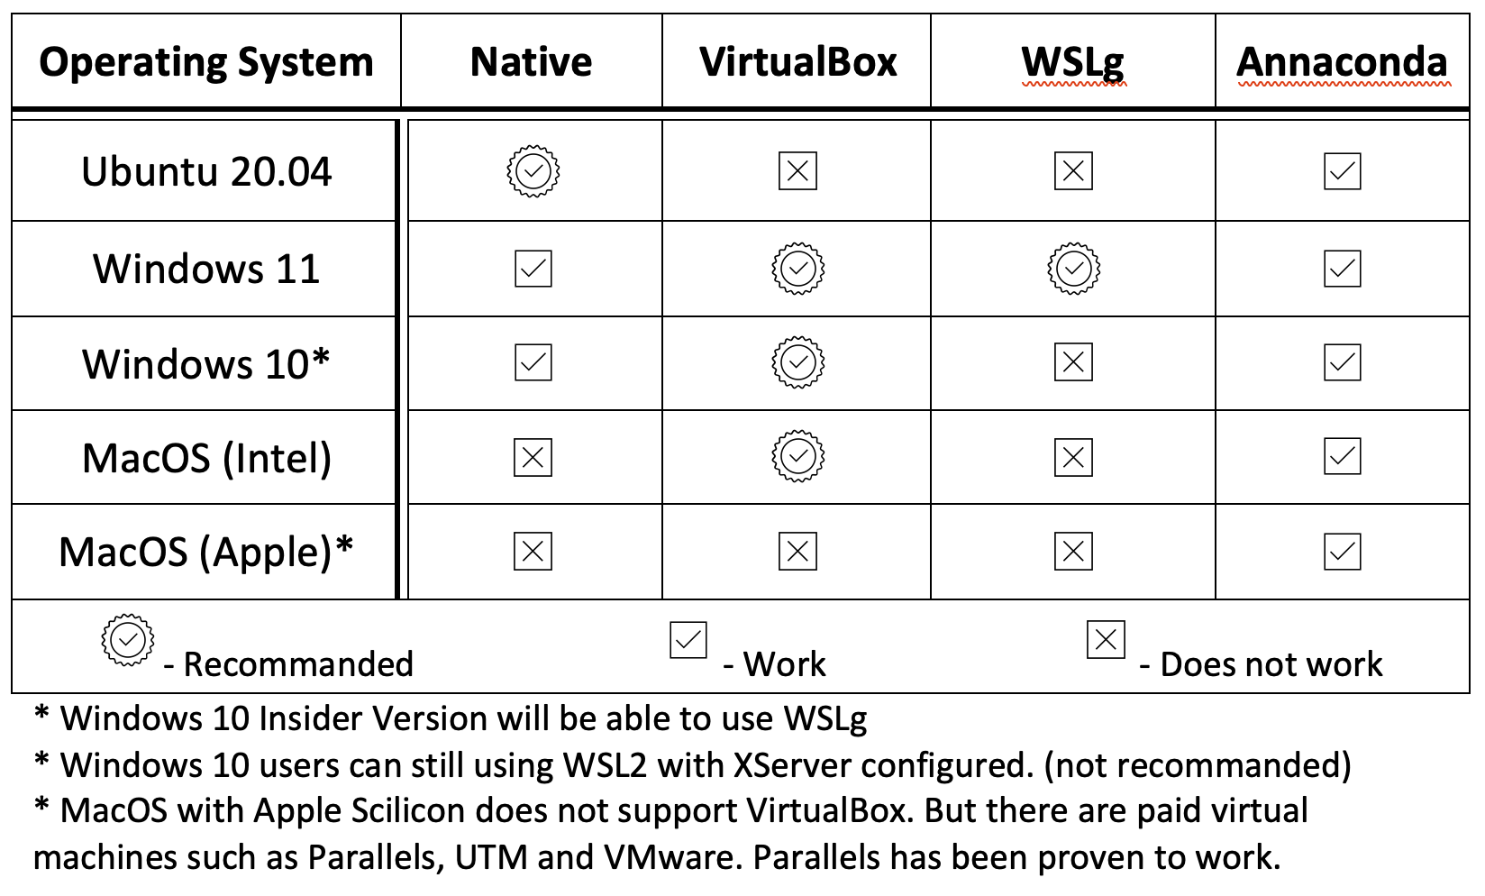
ROS Installation
*Windows 11 & 10 Pro and Home versions were all tested with Intel Integrated GPU.
*Compatibility with Nvidia GPU is not tested.

Slide 3
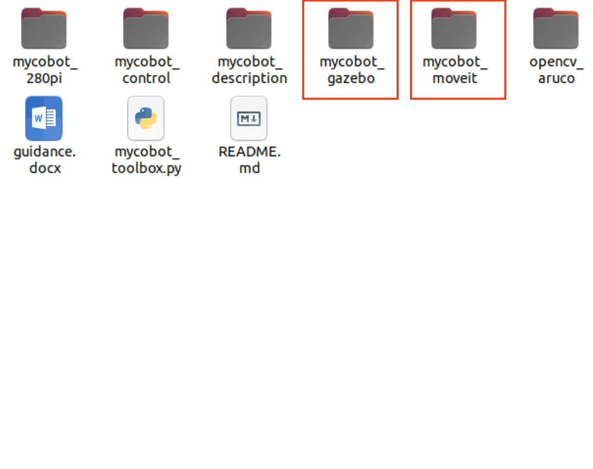
Gazebo Simulation & Move-it
*roslaunch mycobot_moveit demo.launch*
It will launch the simulated environment witin package mycobot_gazebo
In gazebo, the robot is controlled with ros package “controller_manager” with ”joint_state_controller” and “arm_controller”

Slide 4
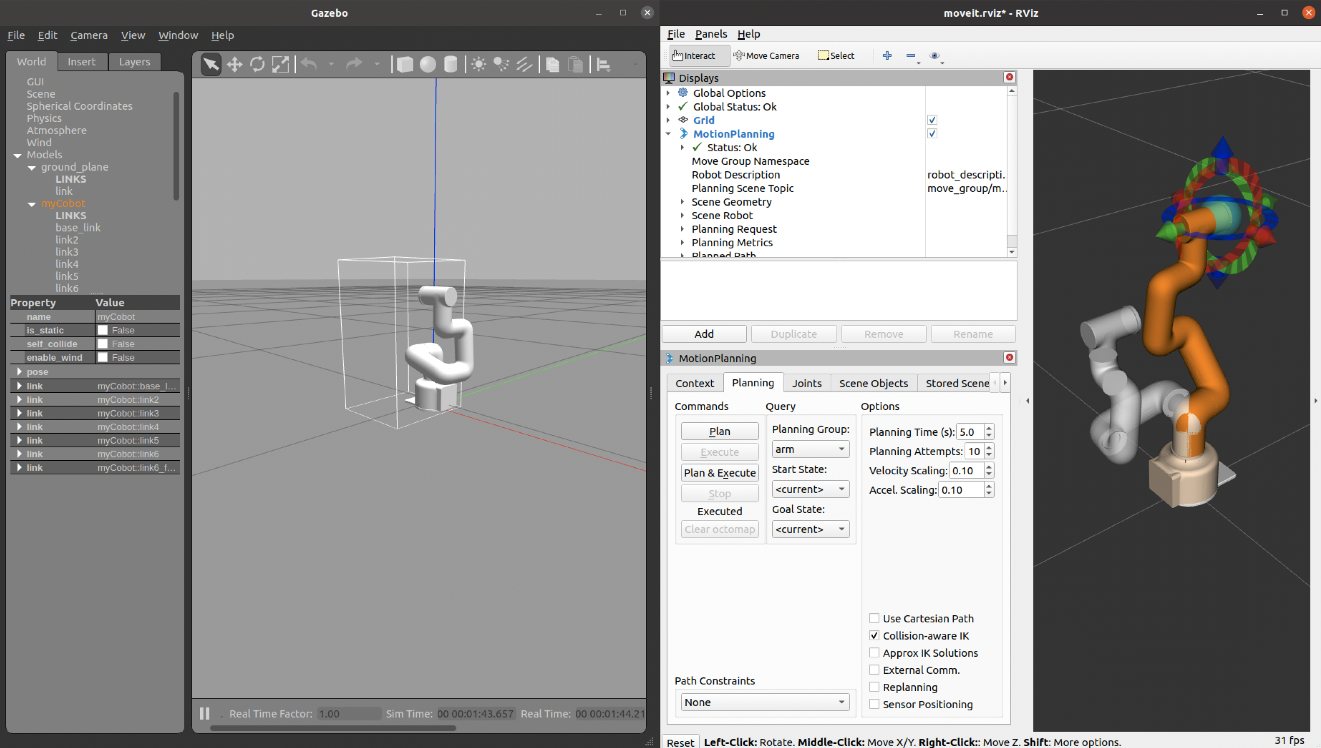

Slide 5
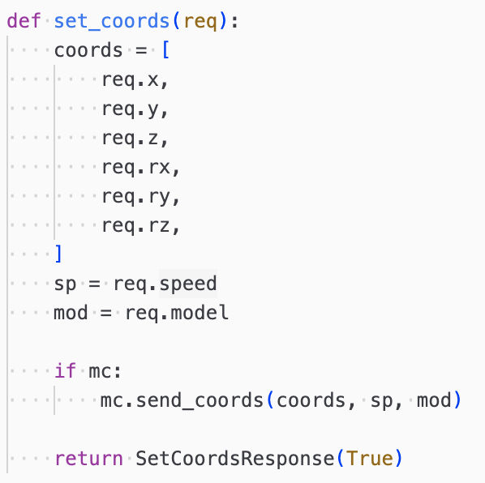
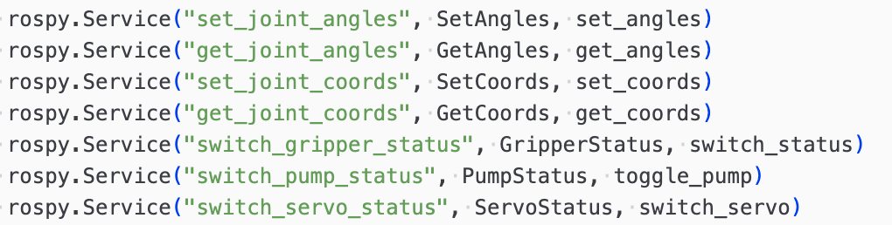
Control Service
Create ROS Service for communication with the robot using the pymycobot python package.
*The if clause can be extended to integrate the ros controllers with simulated environment.

Slide 6
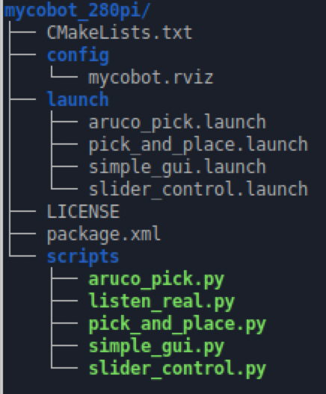
Demo Applications

Slide 7
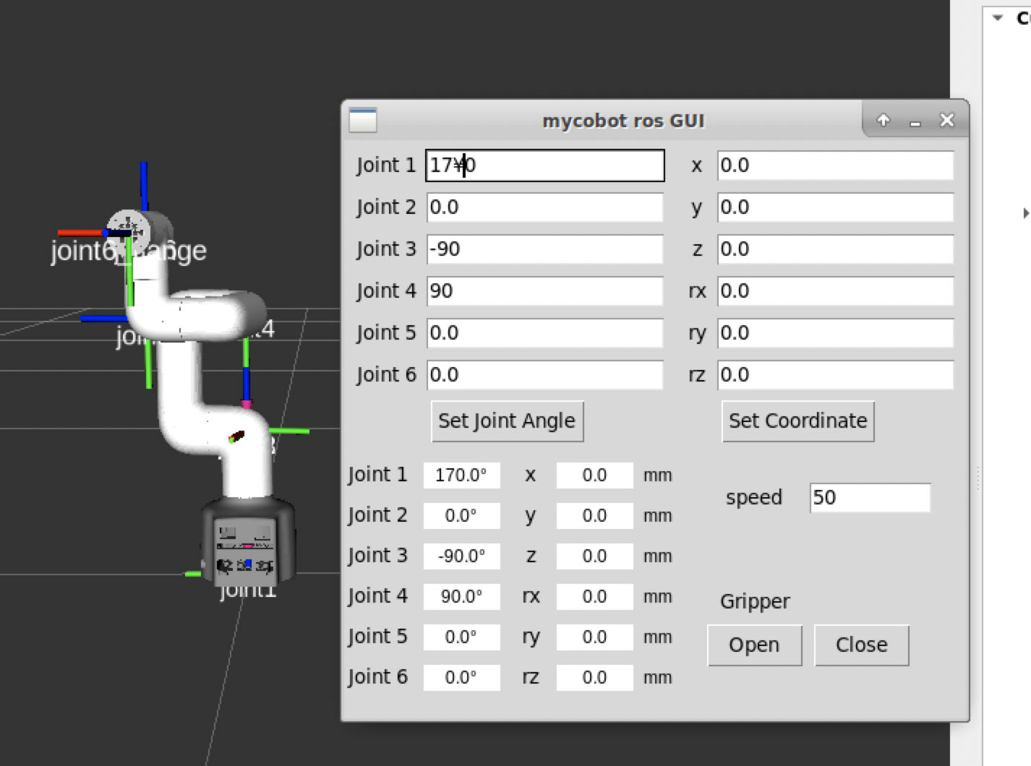
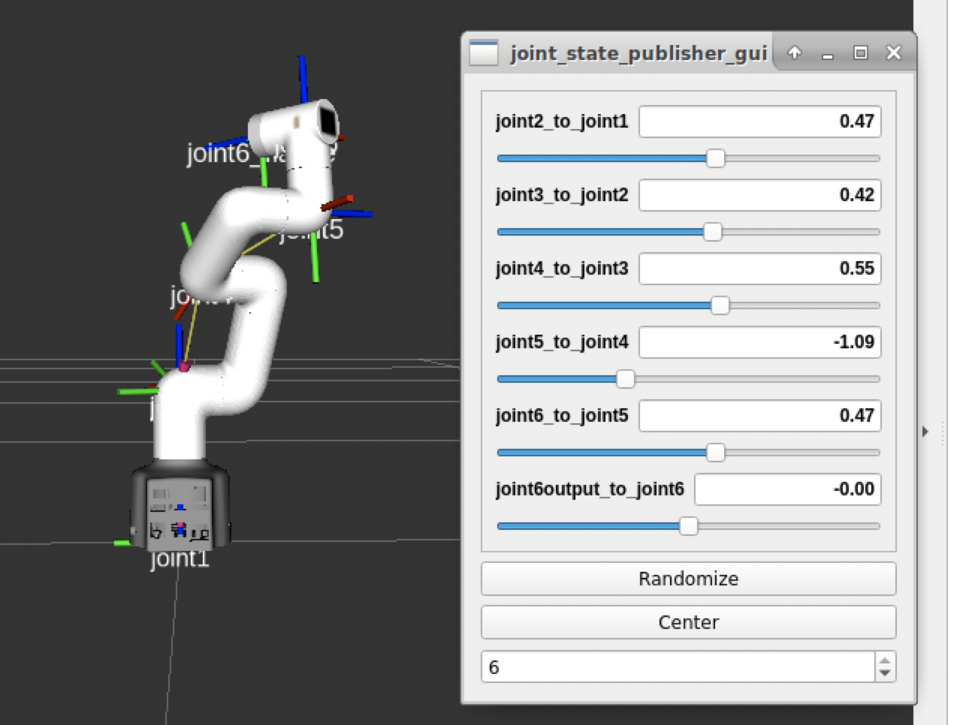
simple_gui
slider_control

Slide 8
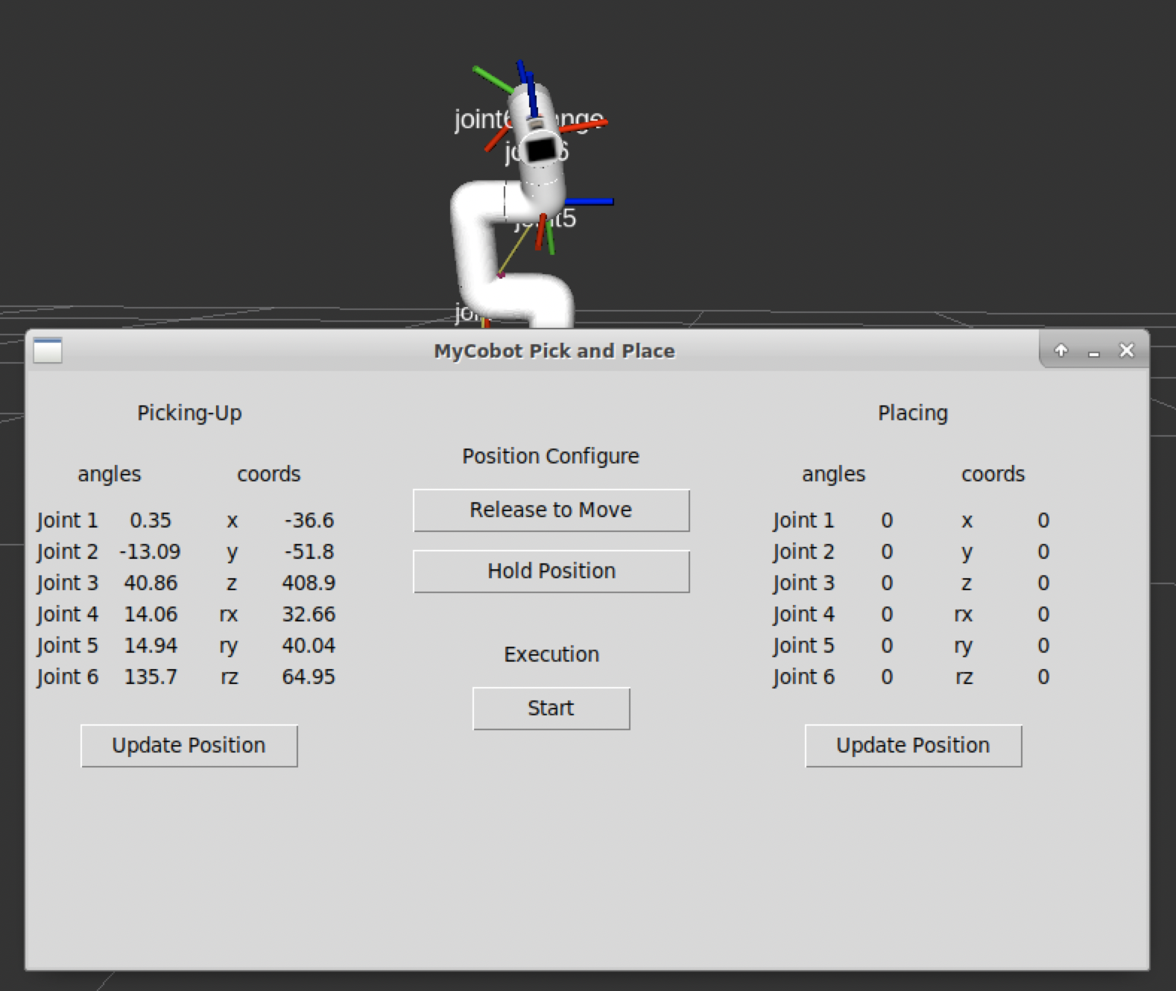
Pick and Place
Release the servos
Move the robot to the desired position and update the coordinates
Execute

Slide 9
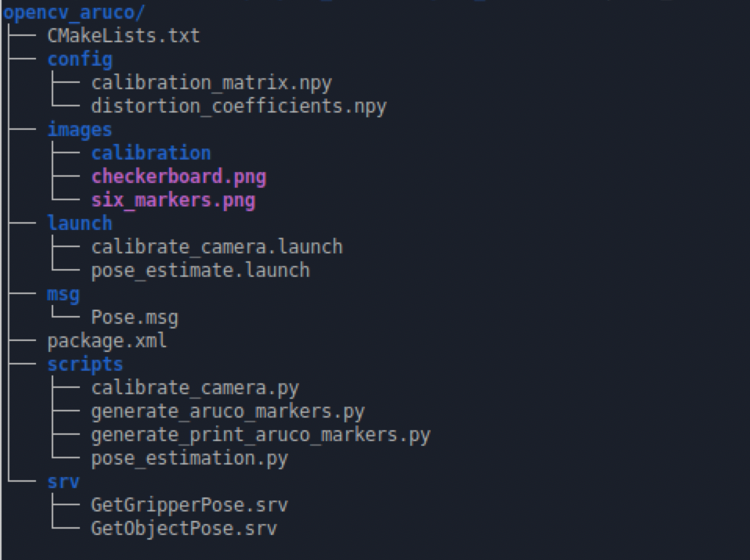
Aruco pick
/images: provide marker images and the checkerboard to calibrate the camera
/scripts: provide script to generate more markers
/calibrate_camera.launch: generate camera calibration matrix
/pose_estimate.launch: publish the pose of markers

Slide 10
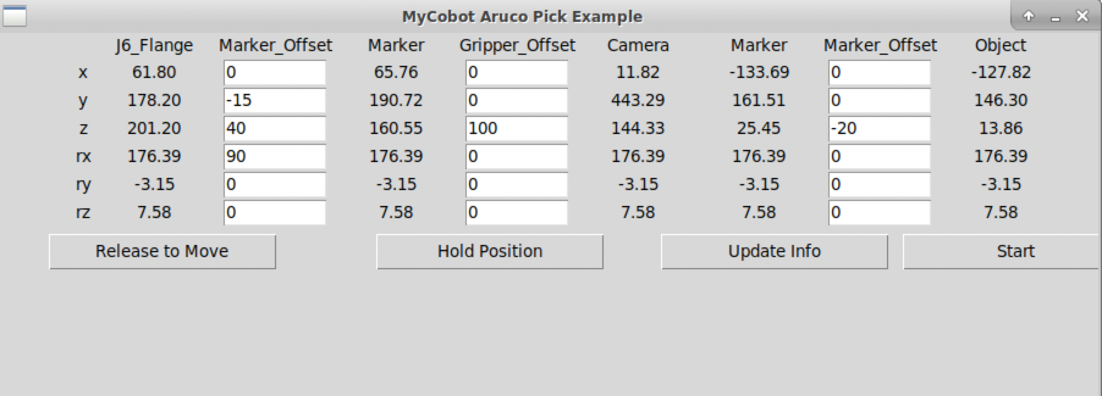
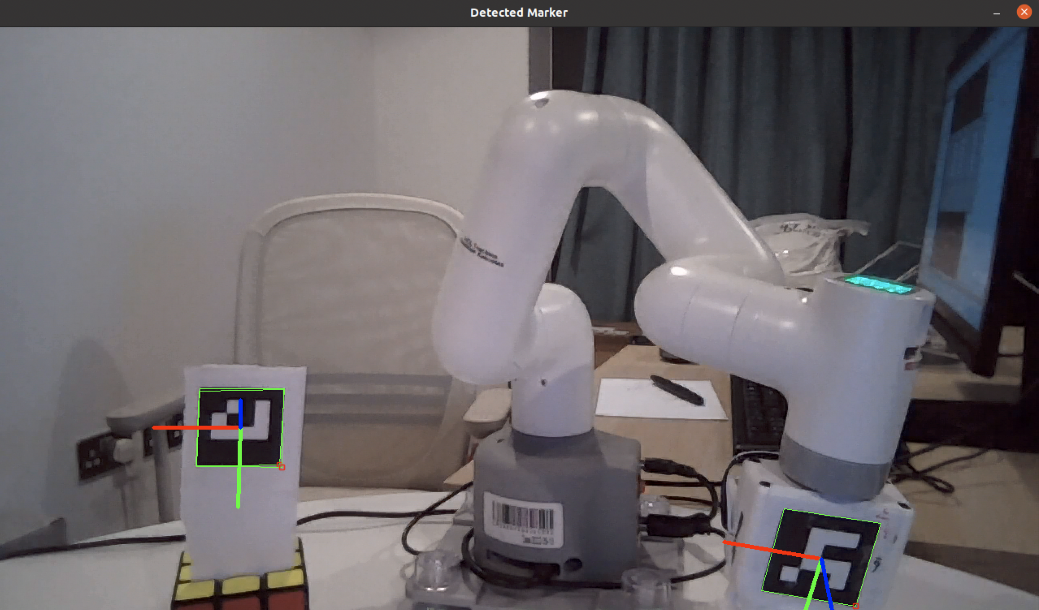
Aruco Pick
Roscore is running on the robot.
The nodes running on the laptop use the webcam to get the markers pose and then publish them.
The nodes running on the robot are to calculated and display the coordinate in base coordinate. (/joint1 in tf)
*rx ry rz is not calculated.

